Slide 2
Create your name tent
Turn in HR paperwork including:
Confidentiality and Nondisclosure
Agreement
Finish the Statements
Complete top section of the Exit
Sheet in the back of the
Orientation Booklet
While You Are
Waiting

Slide 3
Orientation

Slide 4
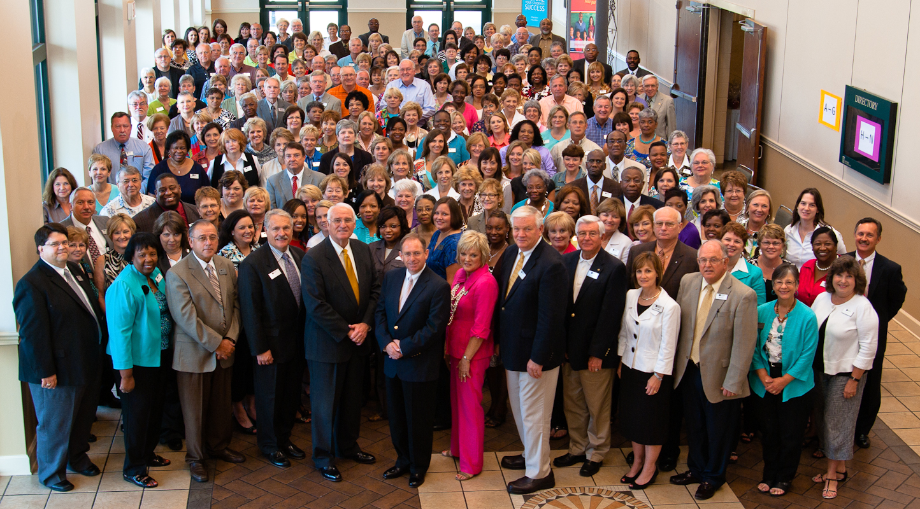

Slide 5
Communicate:
Our mission and the goal of our process
Our core values
An overview of our process and its key components
Objectives

Slide 6
Introductions
Pick a partner.
Briefly interview your partner to identify
Name
Where they live
Current or most recent position
Area of educational passion/expertise
Prepare to introduce your partner to the group using items “a” through “d” above.

Slide 7
Housekeeping Details
Schedule
Location of restrooms
Question Parking Lot
“Finish These Statements”

Slide 8
Points to consider on Becoming a
JBHM Consultant
Computer requirements for consultants
Statement of ethics
Policy on Ethical Conduct in
Consultative Services
Personal Data sheet
Confidentiality/Nondisclosure
Agreement
The Office
of
Human
Resources
Notes:
.

Slide 9
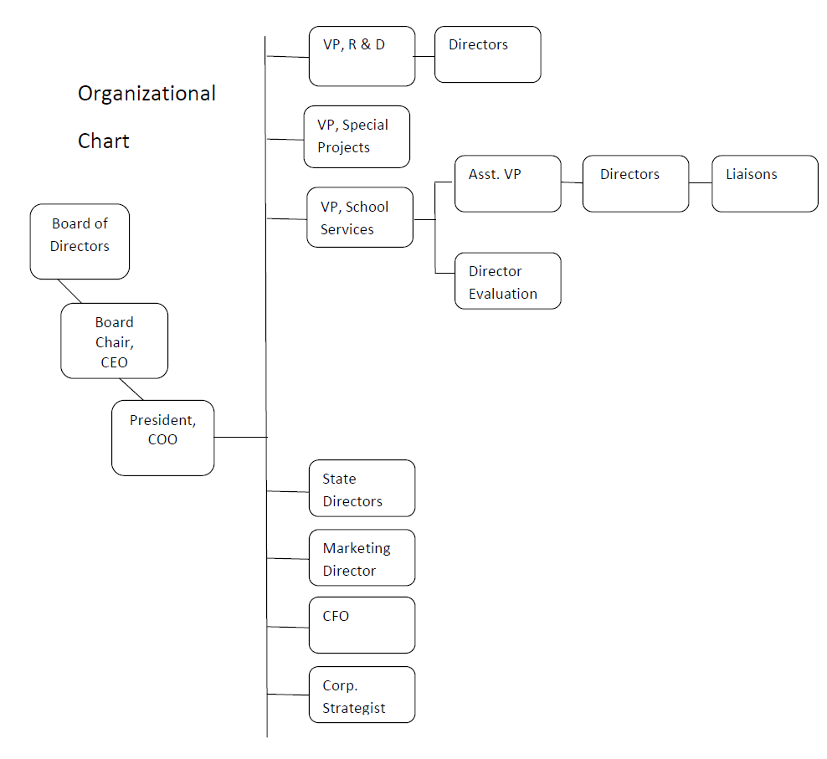
Notes:
9

Slide 10
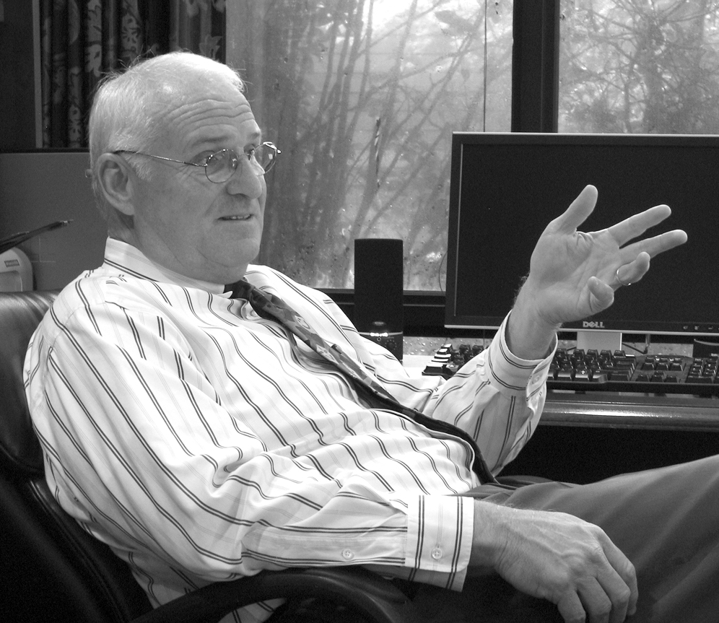
History and Mission
Read or listen to the message from the CEO, Dr. Mike Walters.
Complete the statement , “The Mission of JBHM Education Group is…”
Prepare to share your reflections.
Dr. Mike Walters CEO

Slide 11
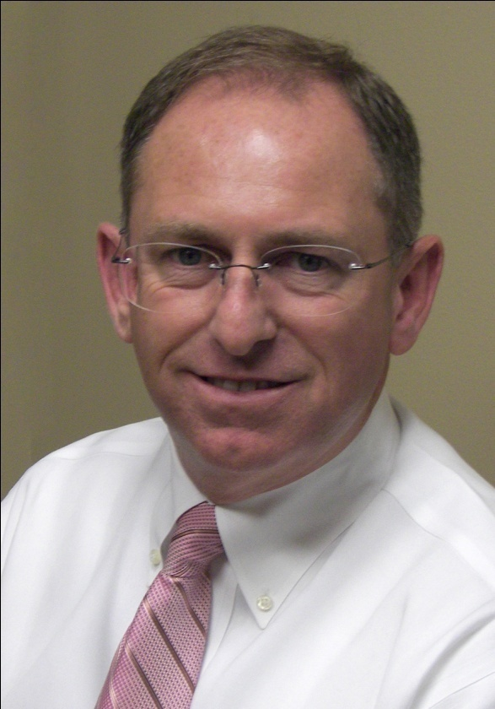
Meet the President
“We are in the success making business. Building successful schools, successful administrators, successful teachers, and – most importantly – successful students!”
Mike McGrevey
President and COO

Slide 12
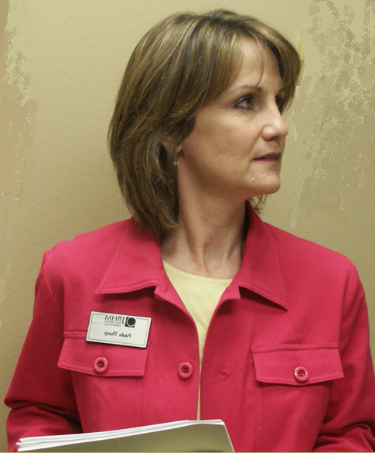
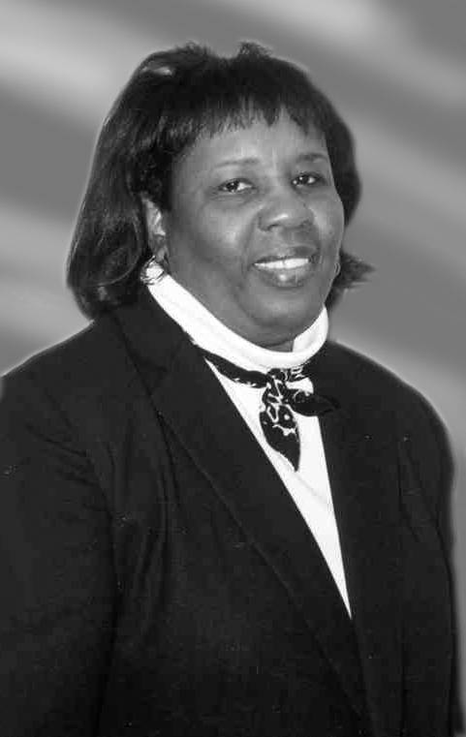
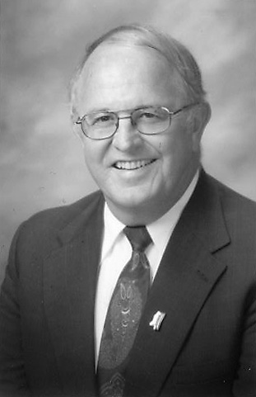
Meet the Vice-Presidents
Paula Tharp
Vice-President
Policy, Research, and Innovation
Evelyn Webb
Vice-President Strategic Programs and Projects
John Patrick
Vice-President School Services

Slide 13
Enhance a school community’s capacity in preparing children for success.
Mission

Slide 14
We are committed to:
The best for children
Quality and integrity
Focus on results
High expectations
High levels of accountability
Success coming from and
belonging to local stakeholders
Special education as an
integral part of the total school
performance process
Core Values

Slide 15
School Improvement
Multiple Applications
Leadership Services
Quinpoint Systemic Improvement Boardroom to Classroom
Teacher Services
Teacher Coaching
Principal Mentoring for School Wide Improvement
Special Services
Struggling Learner
Special Education
Blended Services
including SetPoint
Common Core Support
English Learner
Notes:
15

Slide 16
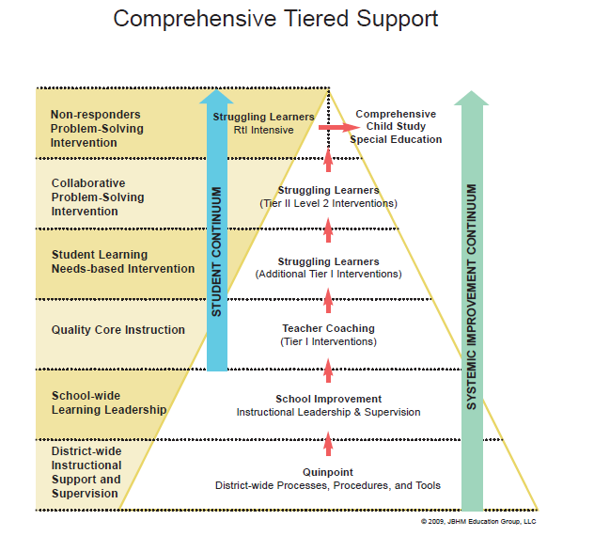

Slide 17
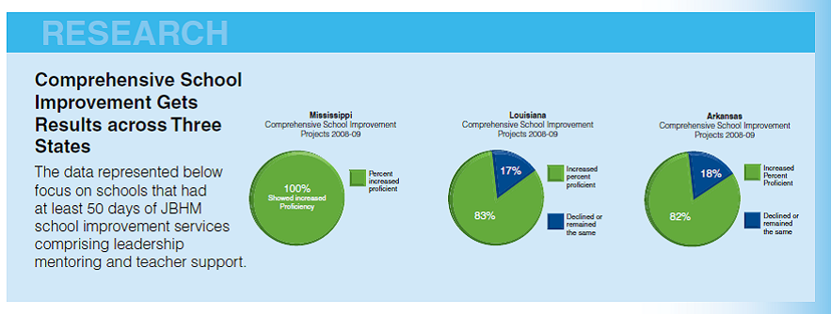
Results
Notes:
17

Slide 18
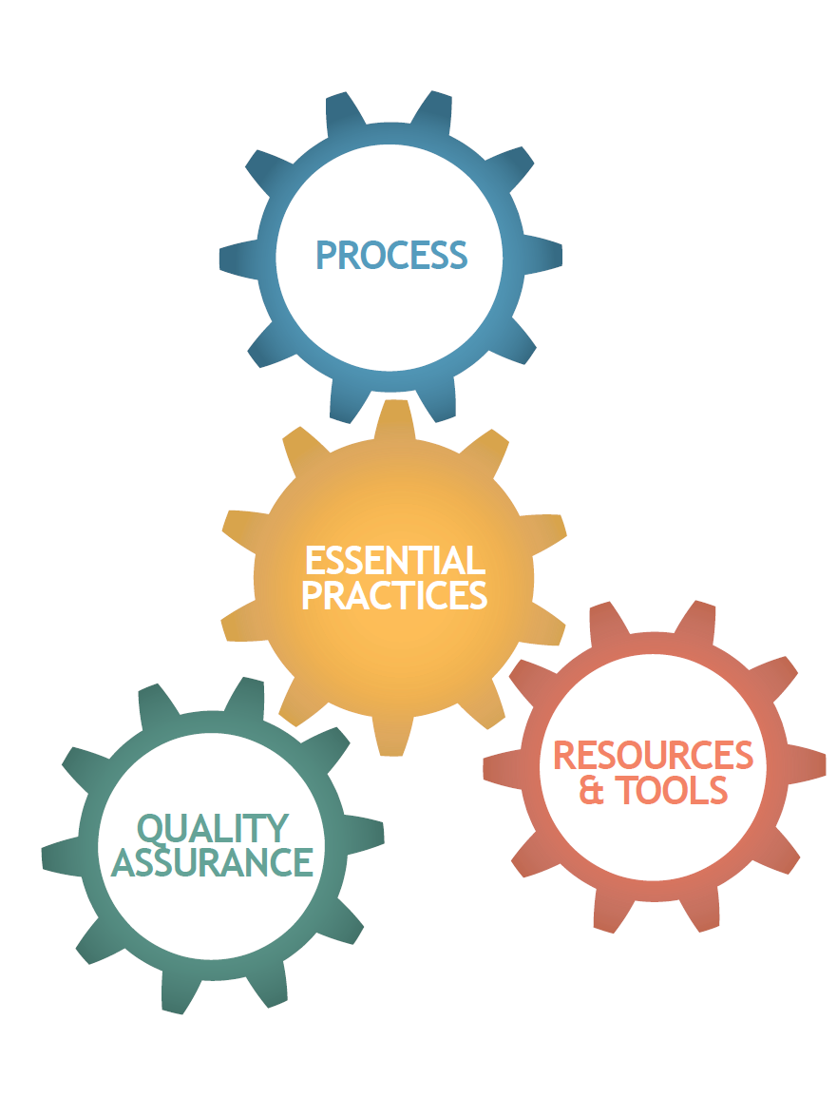
Notes:
18

Slide 19
Providing a Culture and Climate Conducive to Learning
Maximizing Academic Learning Time
Guaranteeing Essential Curriculum
Monitoring Student Achievement
Promoting Professional Practice
Five Essential Practices

Slide 20
Begin at the chart that corresponds to the number of your group.
List two practices that you have observed for this area.
On cue, move to the next chart and add to the list.
Repeat this process on cue until you return to your original chart.
Chart Carousel
Part A

Slide 21
Compare items listed on your original chart to the items on the School/Teacher Performance Rubric. Add items from the rubric that are not on the chart and star them.
As a group, agree on the three most important components and circle them.
Determine who will report to the large group.
Chart
Carousel
Part B

Slide 22
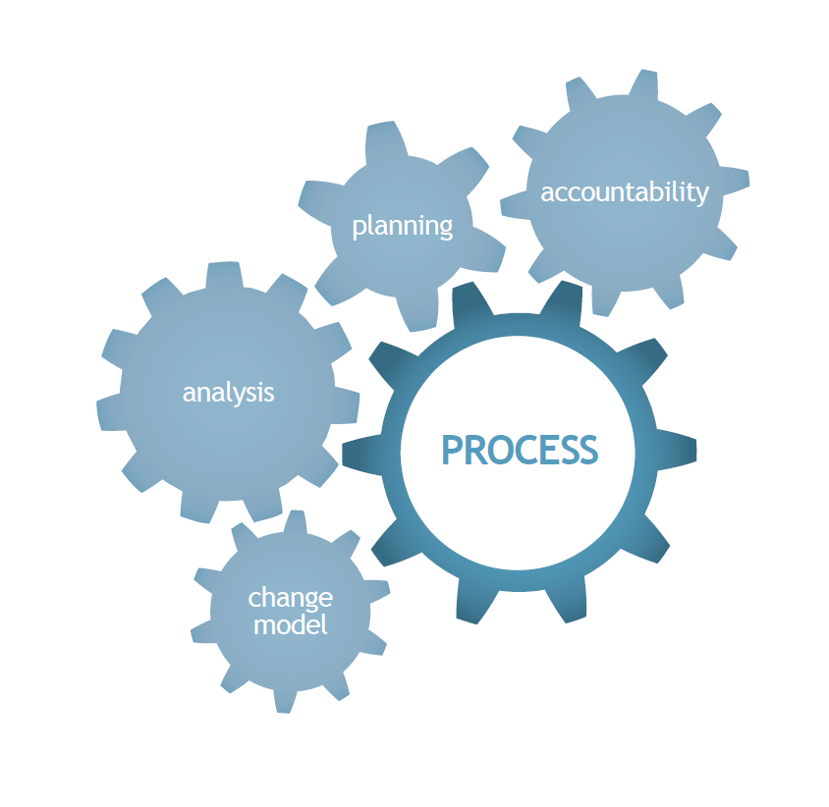
Notes:
22

Slide 23
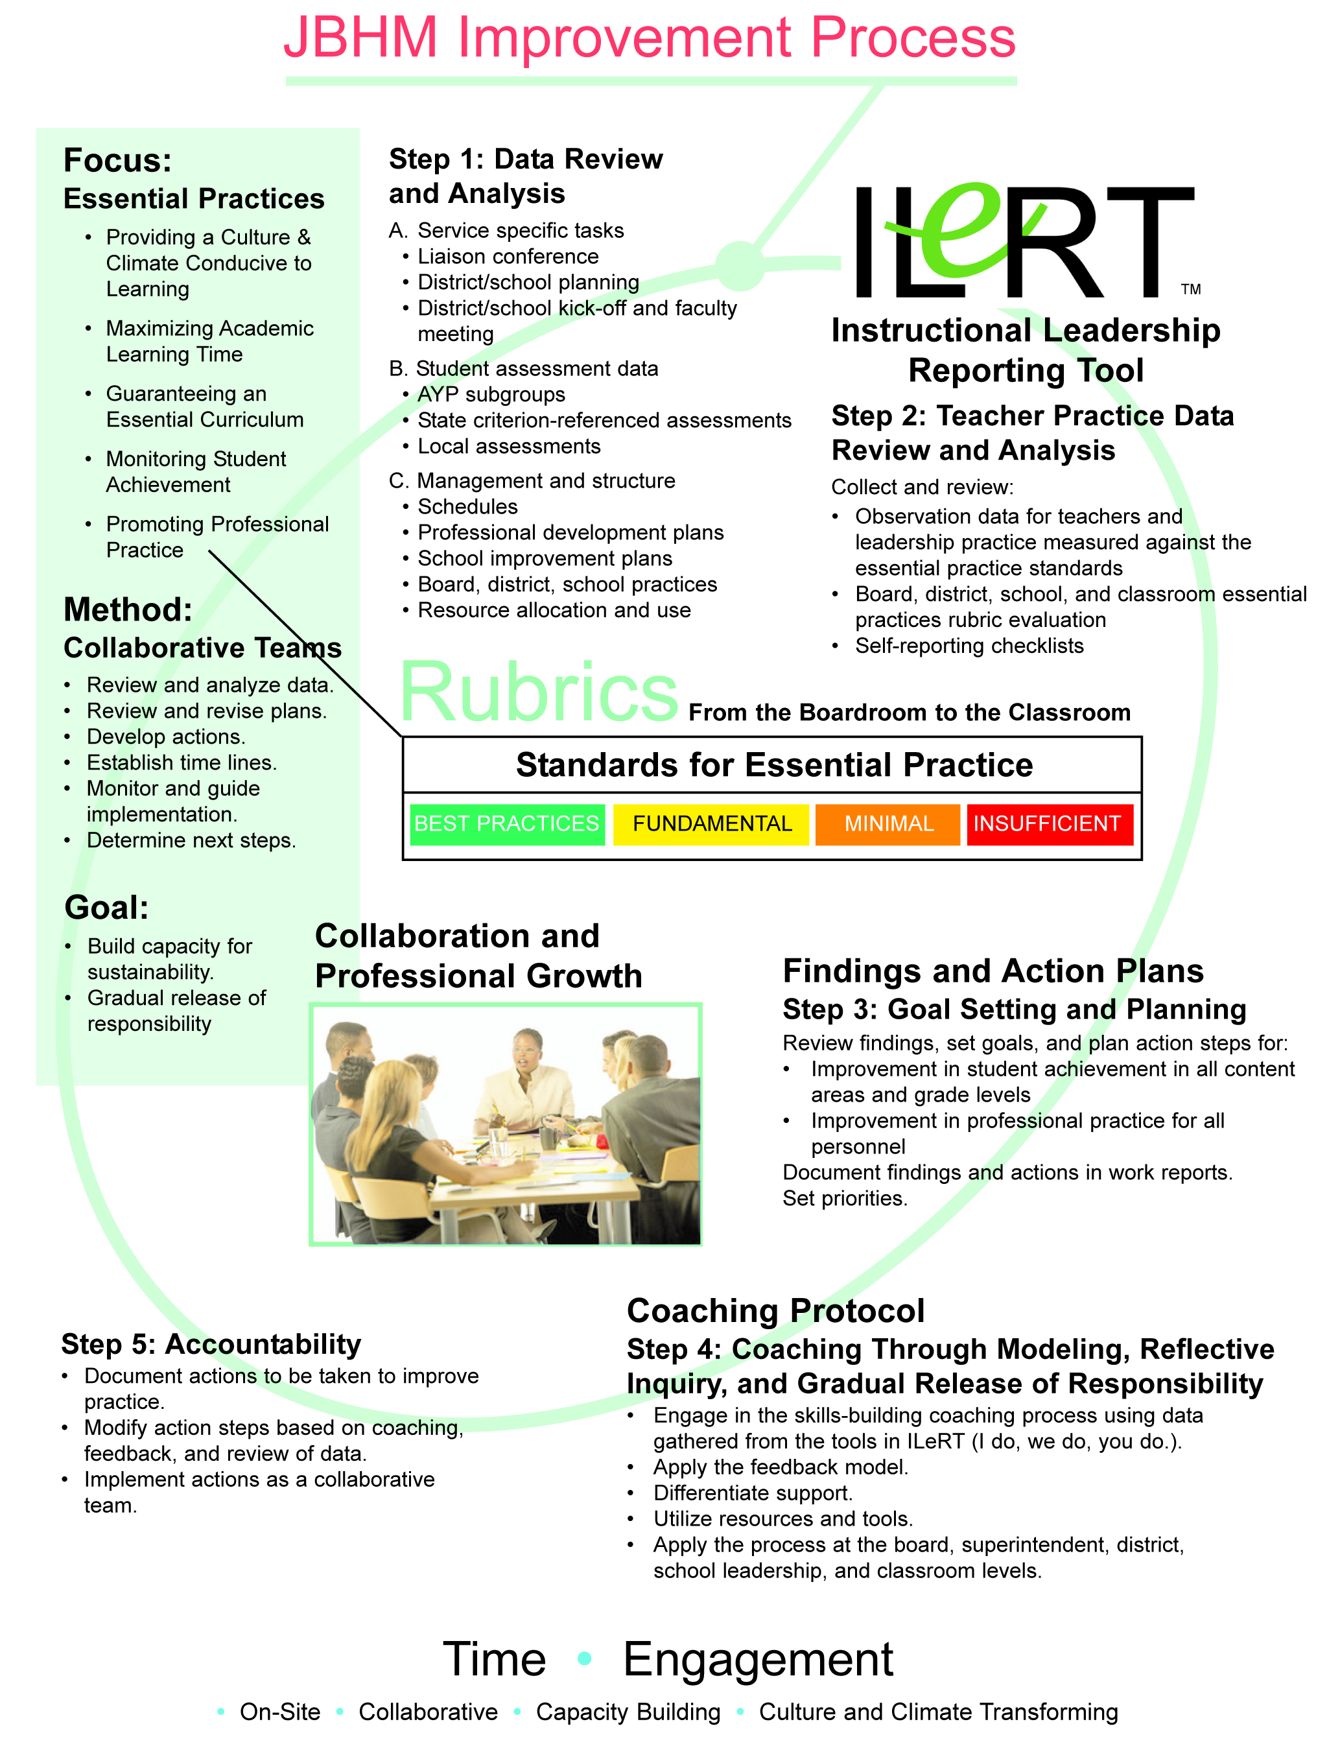
Notes:
23

Slide 24
Notes:
24

Slide 25
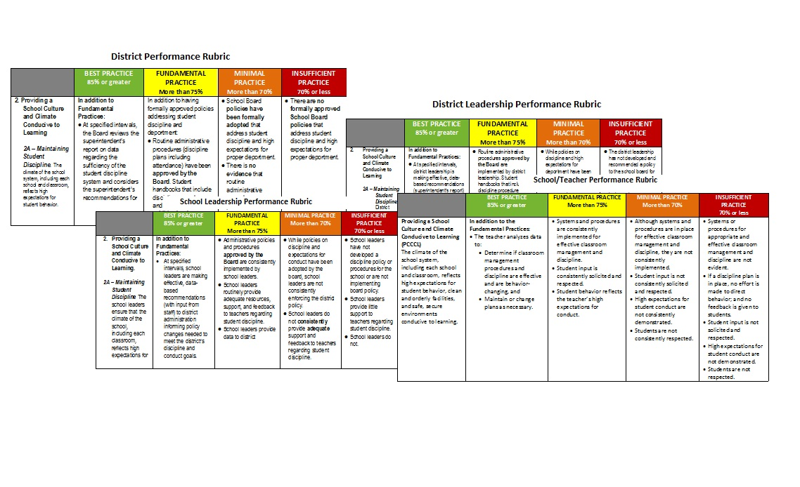
Performance from the Boardroom to the Classroom
Notes:
25

Slide 26
Notes:
26

Slide 27
Notes:
27

Slide 28
Notes:
28

Slide 29
Keys to Accomplishing our Work
Directions:
In table groups, place the statements under the appropriate header: key or barrier. Be prepared to share your answers.
Confront culture of low expectations
Build capacity/transfer leadership
Understand level of difficulty
Understand school data/set goals
Be a change agent
Build community
Maximize learning time
Monitor attendance
Monitor progress and make corrections in instructional practice
Adhere to JBHM process
Notes:
Confront a culture of low expectations in a professional balanced manner
Build capacity and transfer leadership of learning to the local leaders and teachers
Develop a deep understanding of level of difficulty and the ability to transfer knowledge to others.
Maintain a laser-like focus and develop a deep understanding of school data and set goals to identify targeted areas, align strategies and monitor progress to increase student performance.
Be a successful change agent.
Build community to ensure sustainability
Maximize academic learning time
Monitor teacher and student attendance and address concerns in the data
Monitor student progress and make corrections in instructional practice to address weaknesses.
Adhere to the JBHM process.

Slide 30
Barriers to Accomplishing our Work
Become sympathetic/”Going Native”
Get involved in politics of the district
Become overwhelmed/”Hand Wringing”
Allow administrator to direct your work.
Notes:
Barriers
Become sympathetic to factors that contribute to under performance. We call this “Going Native”.
Become involved in the politics of the district. This often leads to other barriers.
Become overwhelmed and straying from the process. We call this “Hand Wringing”.
Allow the administrator to direct your work rather than adhering to the JBHM process.

Slide 31
As you work, consider the rubrics, your role and goals as a JBHM Specialist, and the keys and barriers to accomplishing our work.
Individually identify the ineffectiveness in the scenario and align it to one of the Essential Practices.
Use the School/Teacher Performance Rubric or the School Leadership Rubric to assign a rating.
With your table group, discuss your results, reach consensus, and write an action to be taken to address the ineffective practice(s).
Be prepared to share with the larger group and explain your thinking.
Scenario
Activity

Slide 32
JBHM Specialist Expectations
Directions
Number yourselves from 1-4 until everyone has a number. Follow your leader to the designated part of the room. (5 minutes)
Individually study your portion of the document. (10 minutes)
As a group, reach consensus on the most important information. (5 minutes)
Return to your original table group and teach the information you learned. (10 minutes)
Notes:
32

Slide 33
JBHM Specialist Expectations
Directions
Divide into table groups.
Take one piece of chart paper
fold in into 4 rectangles
bend the center triangle to make a diamond shape when unfolded
label the center diamond, “An Effective JBHM Specialist”
label the 4 quadrants, “Communication,,”“Professionalism,” “Change
Agent,” “Roles”
Set the paper aside
As a group, complete the quadrants in the paper by creating a nonlinguistic
representation or a word or phrase that represents each label related to the
improvement process (as described in the document you reviewed). (15
minutes)
Be prepared to share your work and one key fact that your team discovered
about the JBHM improvement process through this learning task. (10
minutes)
Notes:
33

Slide 34
Folded Frayer Model Directions
Hold a sheet of chart paper like a portrait.
Then fold the sheet in half horizontally.
Now fold the paper in half vertically to create 4 sections if you open it. On the corner where the folds meet, fold a right triangle with the bottom edge of the triangle parallel to the bottom edge of the paper.
Notes:
34

Slide 35
Now open the paper flat, put the word in the center diamond, and label the four sections like they are on a regular Frayer Model.
Notes:
35

Slide 36
Summary of Key Issues:
The Nature and Goal of Our Work
In table groups, discuss the key issues of the
work of JBHM that have been presented
today.
Choose a spokesperson to share two of these
with the larger group.
Notes:
36

Slide 37
Summary of Key Issues:
The Nature and Goal of Our Work
Change Agent
Documenting our Work
Full Day’s Work
Expectations and Accountability for
Specialists
Follow the Process
Notes:
37

Slide 38
Accountability
Rubrics
Mid-Year Accountability Checklist
Work Reports

Slide 39
“We cannot afford to fail. If we fail, our schools fail, students lose, teachers lose, leaders lose, communities lose and we are out of business.”

Slide 40
Objectives
Communicate:
Our mission and the goal of our process
Our core values
An overview of our process and its key components

Slide 41
For each of the current research topics in the table, select your level of expertise to help us better determine and meet training needs.
2. List the JBHM Service(s) that most
appropriately match your
expertise.
3. List educational issues about which
you are passionate which are
compatible with the JBHM School
Improvement Process.
Exit Sheet

